Slide 1
CSCI-599 Machine Learning for Games
Team Project Report
Akshansh , Shashank , Rishabh

Slide 2

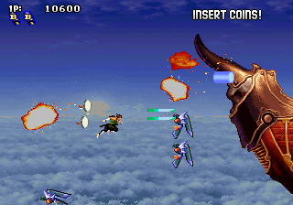
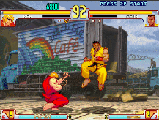

1
Reminder of our topic project
Using Gym Retro
Gym Retro + NEAT-Python

Slide 3
PHASES:
Using Open AI –Universe Too many errors and mujoco needs licensing
Using CNN with 10 layers deep and Reinforcement Learning
Training too slow
Difficulty in setting reward function
https://en.wikipedia.org/wiki/Neuroevolution_of_augmenting_topologies#Implementation

Slide 4
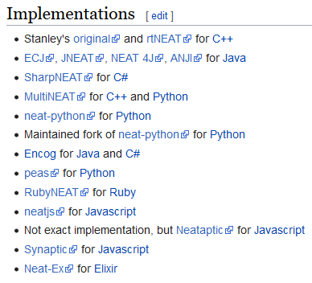
2
NEAT-Python?
NEAT: Neuro-evolution of Augmenting Topologies
NEAT-Python Package implemented in Python With NEAT
Of Neural Network structure and parameters `learning`in the genetic algorithm to use
Learning speed is considerably
faster than other algorithms
such as Back Propagation
https://en.wikipedia.org/wiki/Neuroevolution_of_augmenting_topologies#Implementation

Slide 5
2
NEAT-Challenges Solved
Is there a genetic representation that allows disparate topologies to crossover in a meaningful way?
Use historical markings to line up genes with the same origin
How can topological innovation that needs a few generations to optimize be protected so that it does not disappear from the population prematurely?
Separate each innovation into a different species.
How can topologies be minimized throughout evolution without the need for a specially contrived fitness function that measures complexity?
Start from a minimal structure and grow only when necessary
https://en.wikipedia.org/wiki/Neuroevolution_of_augmenting_topologies#Implementation

Slide 6
3
Genetic Algorithm (GA)
Natural selection and evolution to mimic optimization techniques Reassemble the High-Score year to create a new year, and discard the low-score Year
Therefore, it is possible that the actual `learning`does not
occur
Objective: max f | f(x)=x₁+2x₂+3x₃
Solutions | s⁽⁰⁾=(2, 1, 0) | s⁽¹⁾=(1, 1, 1) | s⁽²⁾=(0, -1, 3)
Score f(s) | 4 | 5 | 7

Slide 7
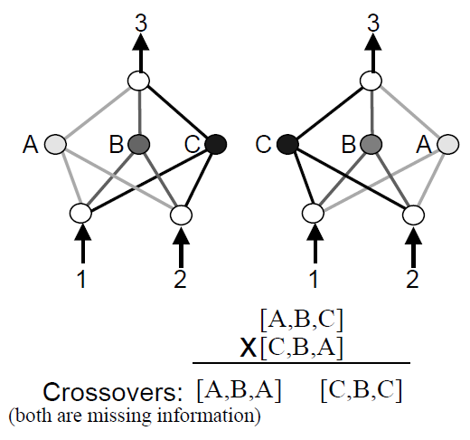
4
Neuro-evolution
Build NN with GA (weight tuning, structure)
Weight tuning easy (average, random select, …)
Competing Conventions Problem

Slide 8
5
How NEAT deals with Pooling
History marker Tracking the Origin of Genes by Placing ` When the vertex or edge first appeared
Speciation
Potentially Good Neural Network Models Can Survive
Gradually grow neural networks starting from a minimal structure Alternate weight tuning and structure search
Evolve RNN model that takes action by taking state using NEAT-Python

Slide 9
6
Trial: training sonic with RNN
Buttons (12)
[ B , A , MODE , START , UP , DOWN , LEFT , RIGHT , C , Y , X , Z ]
Actions (8)
[ [ ] , [LEFT] , [RIGHT] , [LEFT, DOWN] , [RIGHT, DOWN] , [DOWN] , [DOWN, B] , [B] ]
Reward
rew = (curr_x - init_x) + ring + completion_bonus

Slide 10
Trial: training sonic with RNN
Model
train model
experience_batch
update step_model
step model
TEXT
env
TEXT
TEXT
Result
Slow when learning → Give up
TEXT

Slide 11

7
Training sonic with NEAT
Evolving Feedforward Network (resolution : 320 * 224 inputs → button press : 12 outputs)
Activation Function : Sigmoid
Maximum Stagnation : 50 Generations
1120
(40 * 28)
12 Input Buttons
Population : 20 Genomes

Slide 12
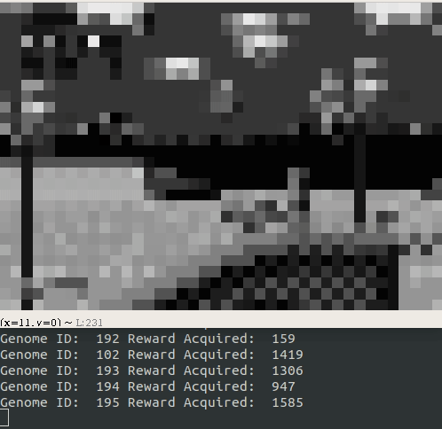
Training Sonic with NEAT
Trial 1
Input:
- Screen Frame Values
- Gray Scale
- ⅛ Resolution
$
Reward:
Move to the right (Naive approach) Every time Sonic's x-coordinate exceeds the current maximum to the right, Fitness Score: +1 per frame

Slide 13
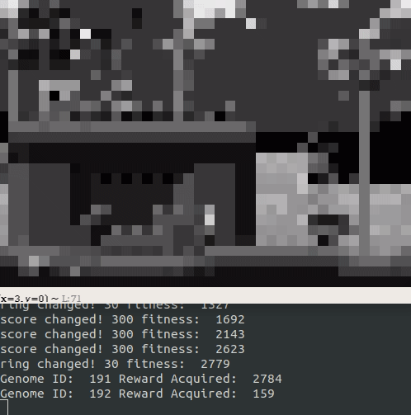
Training Sonic with NEAT
Trial 2
Input:
- Screen Frame Values
- Gray Scale
- ⅛ Resolution
Reward:
Move to the right, earn Ring, score first enemy points -Whenever Sonic's x-coordinate exceeds the current maximum to the right: +1 per frame -Whenever a new ring is acquired / lost: ± 30 per ring -Every time you kill an enemy: 30 * Gain Point
$

Slide 14
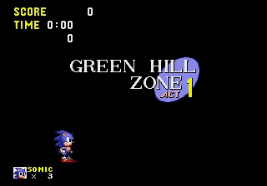
8
Result – Demo & Video
Early Stage

Slide 15
8
Result – Demo & Video
Mid Stage

Slide 16
9
We decided to use Gym-Retro which has many information sources and is convenient for environment construction .
NEAT starts with population of simplest networks
where no hidden neurons or connections are given.
- The topology is incrementally augmented via two
mutation operators, adding nodes and adding links.
Conclusion

Slide 17
10
Change mutation function to have more variance in genome population
Use best score from past experience for Crossover
Vary Population size to effect on stagnation
Include age for reward policy
Future Work

